Slide 1

Convolutional Neural Network (CNN) for Image Classification using Parallel Pipeline Training
Notes:
Line spacing + Page numbers

Slide 2
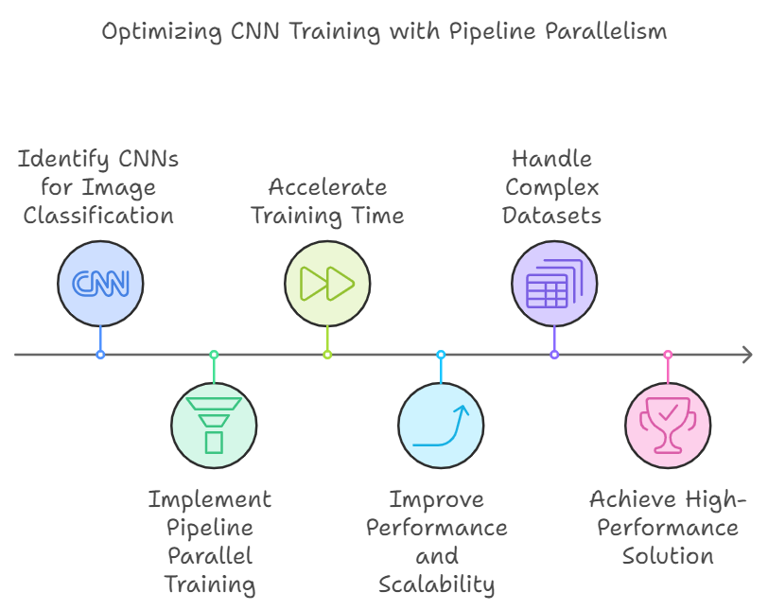
Convolutional Neural Networks (CNNs) have proven to be an exceptional choice for image classification due to their ability to efficiently capture and learn relevant features from images, leading to accurate and robust classification results. In our project, we focused on optimizing the training process by leveraging parallel pipeline training techniques. This approach significantly accelerated the training time, improving both the performance and scalability of our CNN models. By utilizing parallelism, we were able to handle more complex datasets and models with greater efficiency, resulting in a high-performance image classification solution

Slide 3
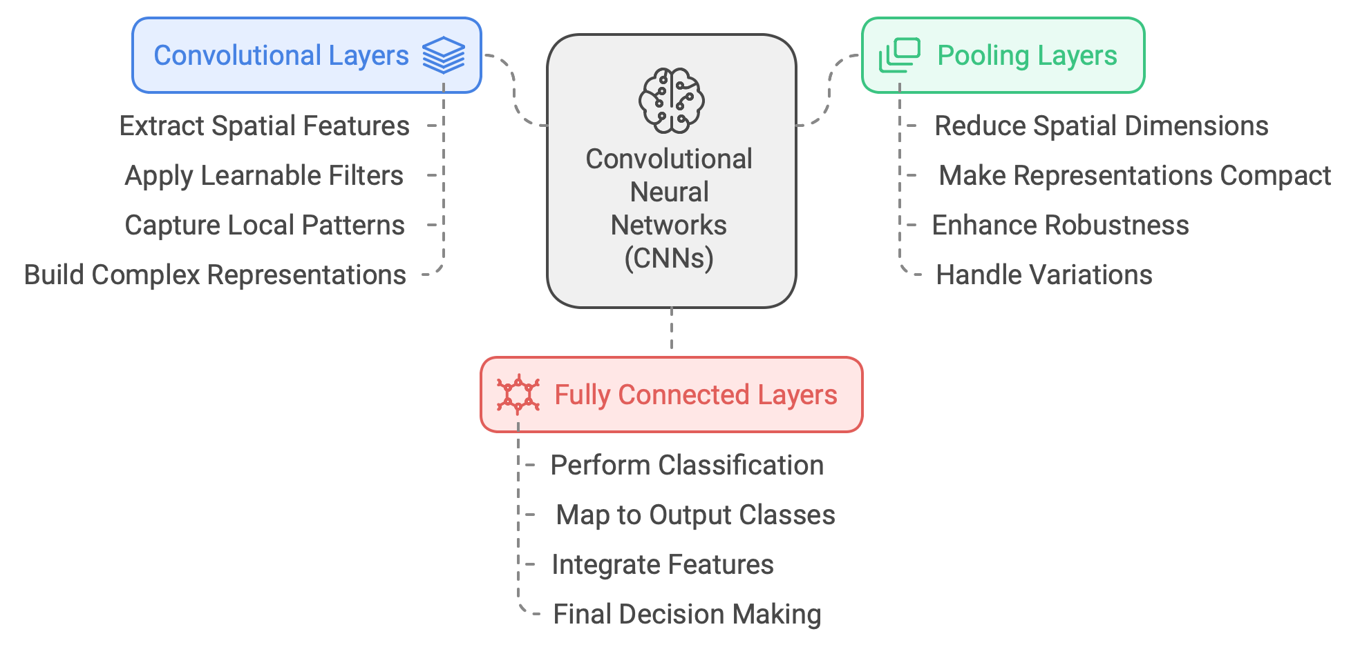
Fully Connected Layers
The final layers of a CNN are typically fully connected layers that take the extracted features and perform the classification task, mapping them to the desired output classes.

Slide 4
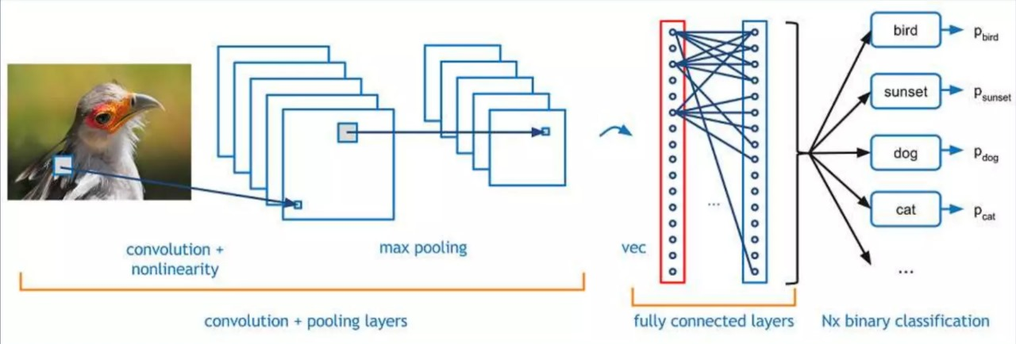
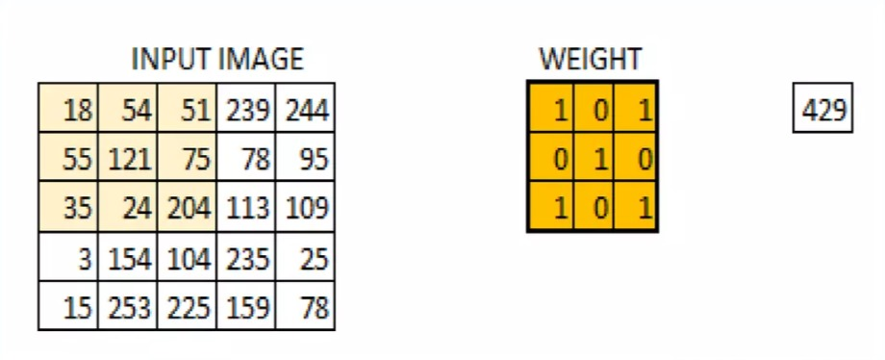
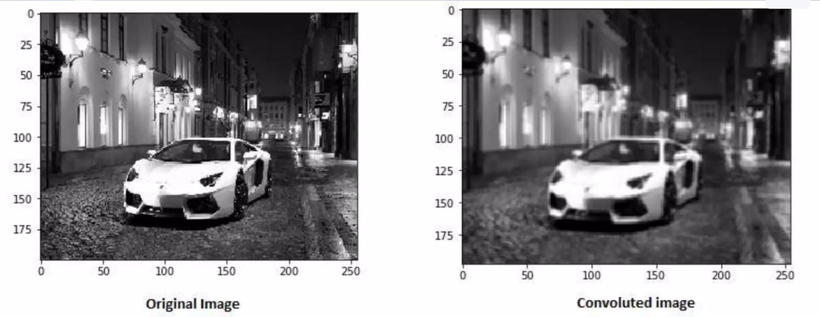

Slide 5
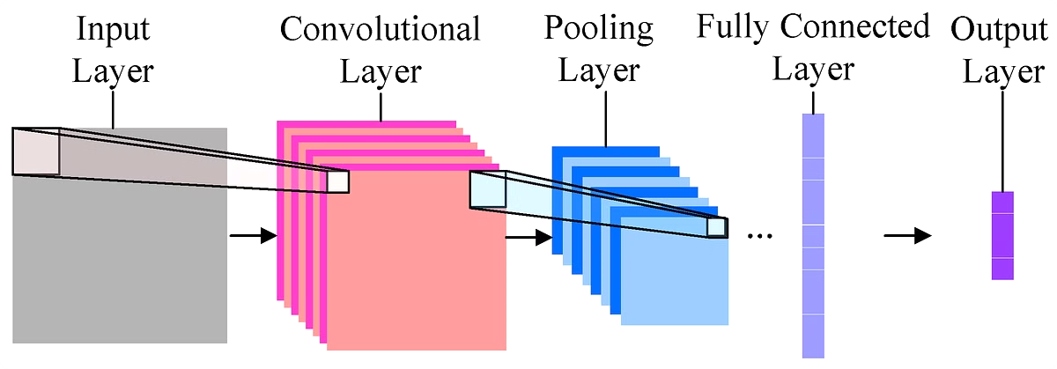
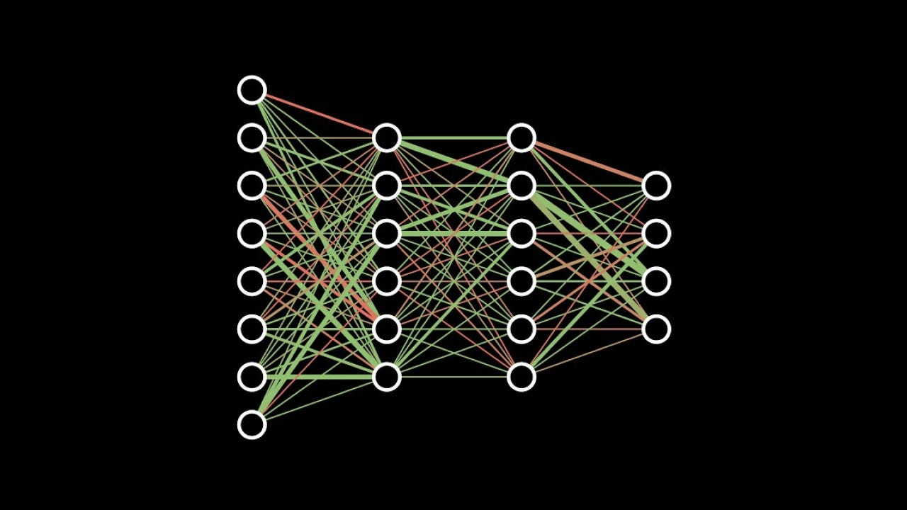
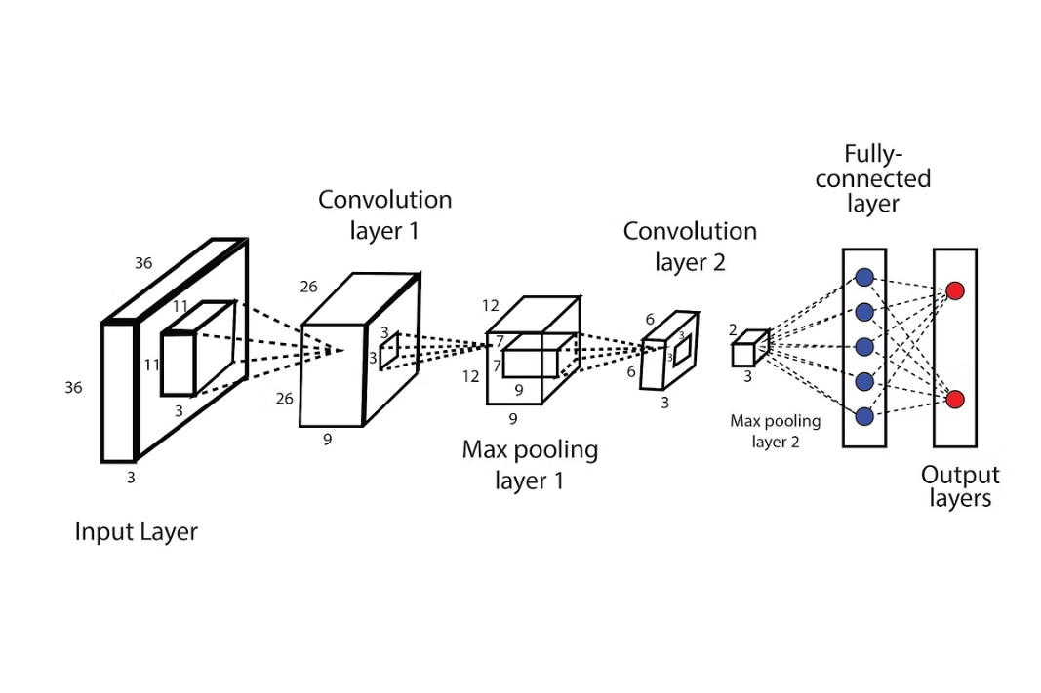

Slide 6
Convolution Operation
For a 2D input image I and a 2D kernel K, the convolution operation can be defined as:
I(i,j): The pixel value at position I(i,j) in the input image.
K(m,n): The weight of the kernel at position (m,n).
S(i,j): The output feature map at position (i,j).
Zero Padding: The simplest form of padding, where additional pixels with a value of zero are added around the image.
Stride
Controls how much the kernel shifts as it slides over the input image.

Slide 7
Activation Functions
Activation functions introduce non-linearity into the network, allowing it to learn more complex representations.
ReLU (Rectified Linear Unit):
Formula : f(x) = max(0, x)
Fully Connected Layers
Matrix Multiplication in Fully Connected Layers
Given an input vector xx and a weight matrix W, the output z is calculated as:
Formula: z = Wx + b
Where:
W is the weight matrix.
b is the bias vector.
z is the output vector.

Slide 8
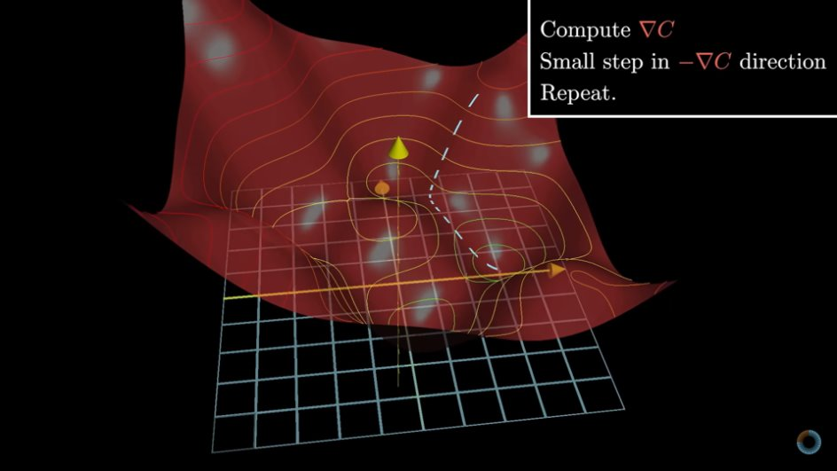
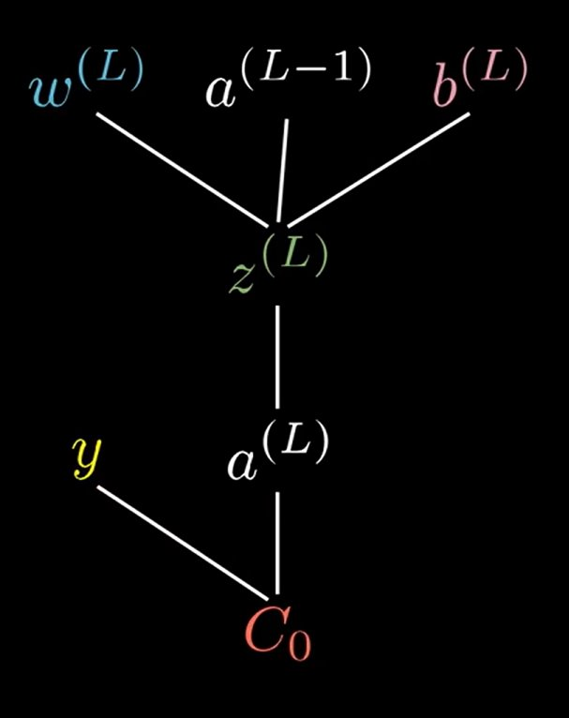
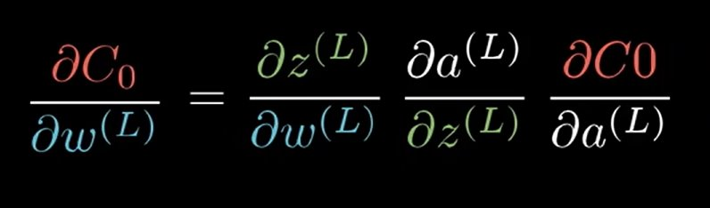

Slide 9
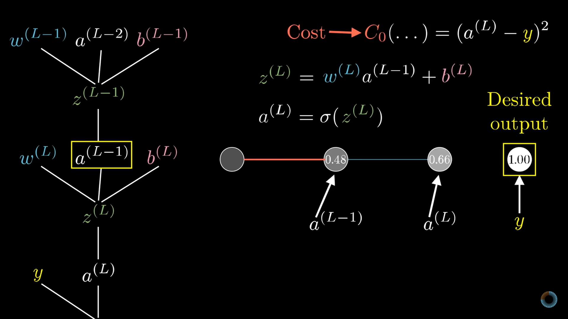

Slide 10
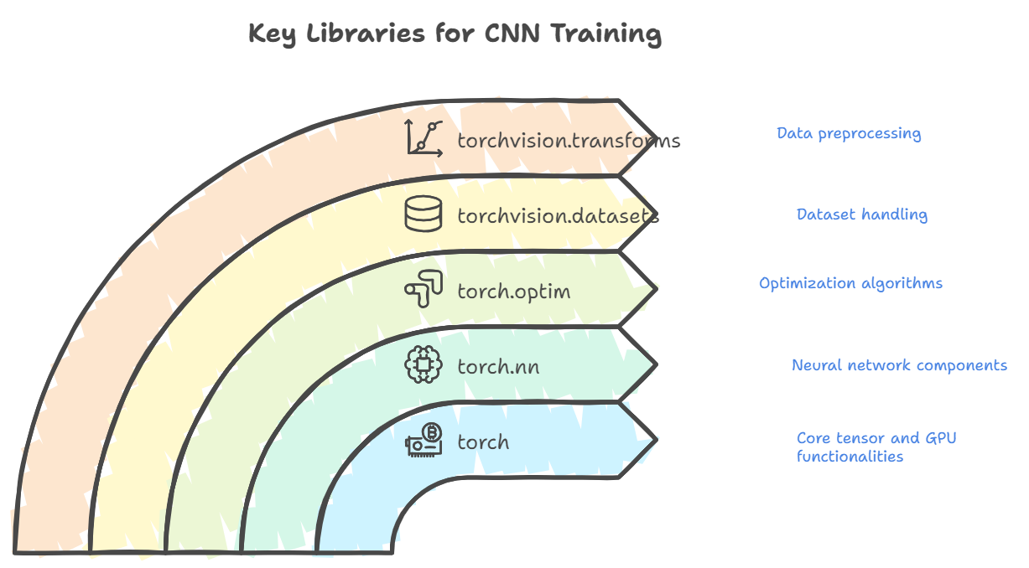

Slide 11
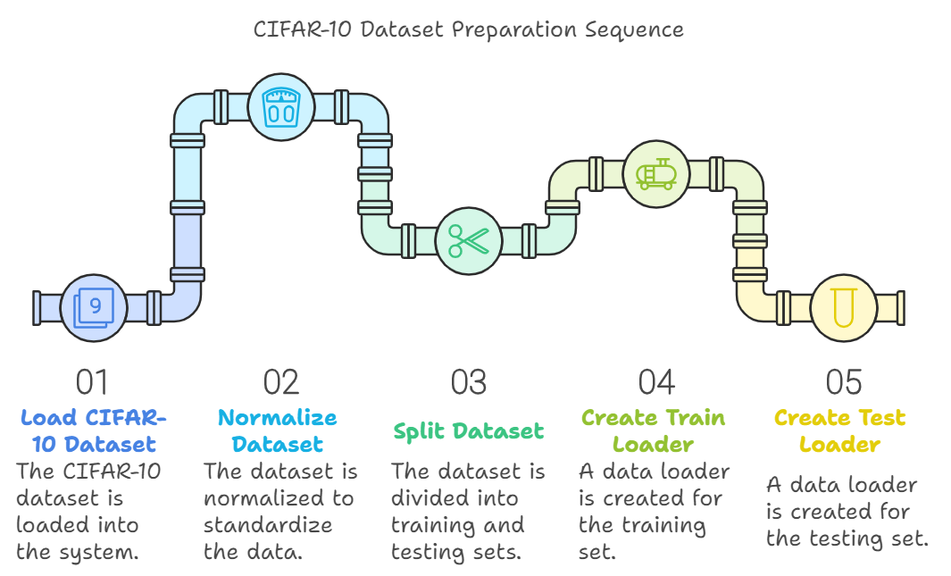

Slide 12
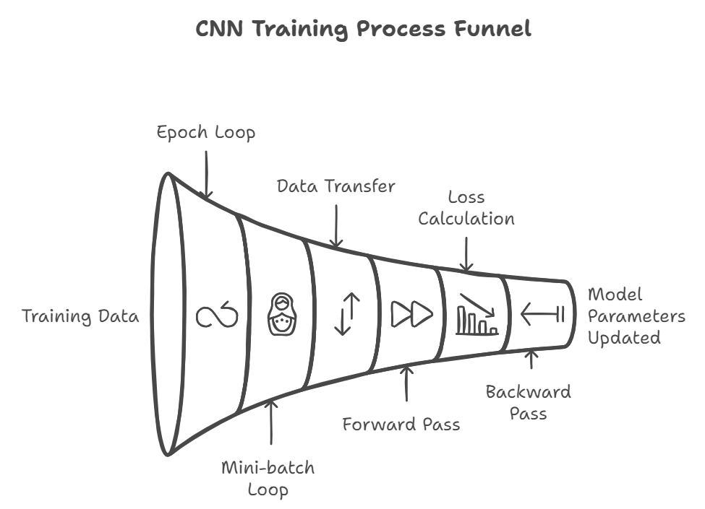

Slide 13
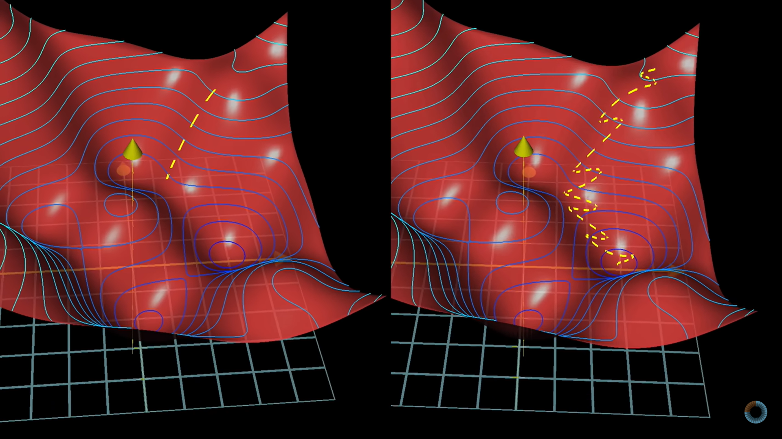

Slide 14
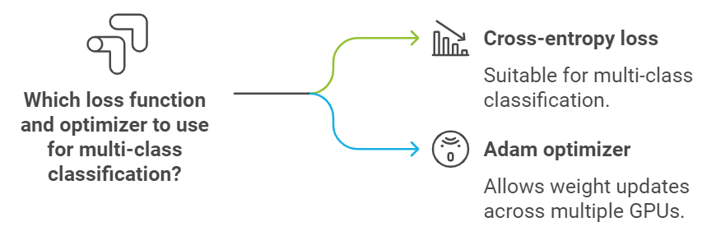

Slide 15
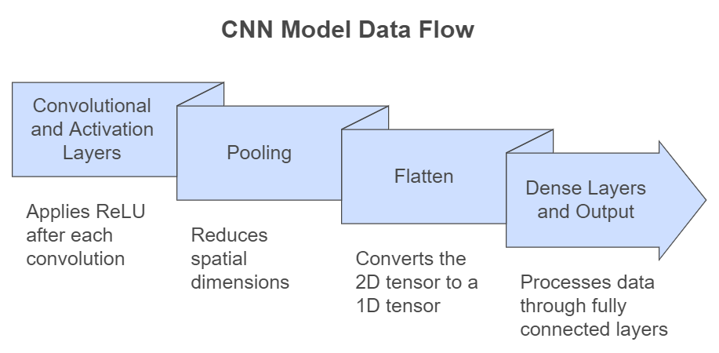

Slide 16
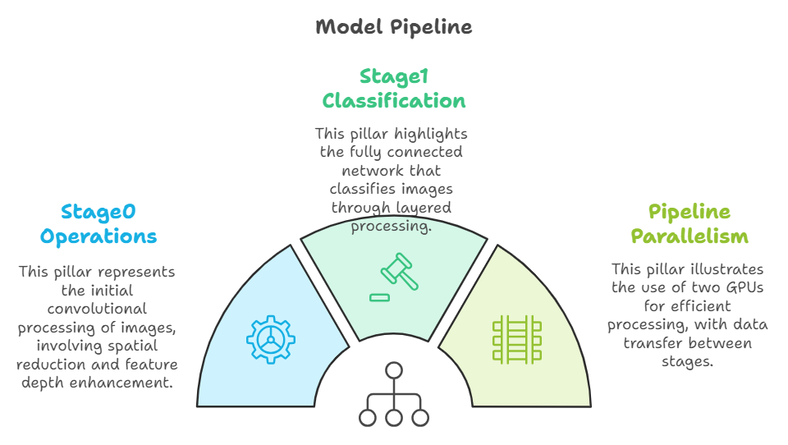

Slide 17
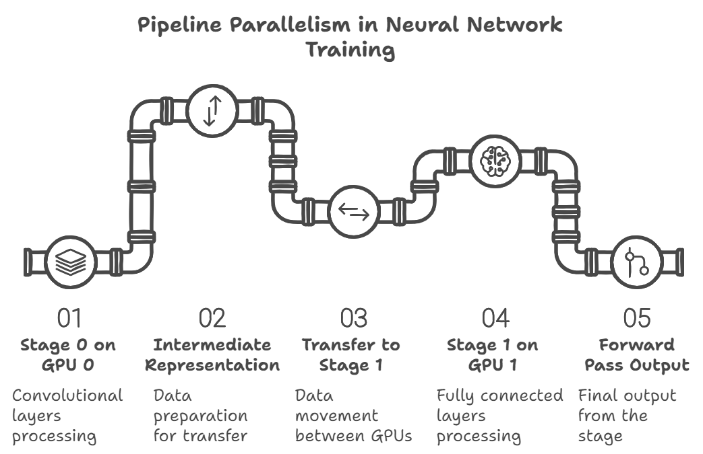

Slide 18
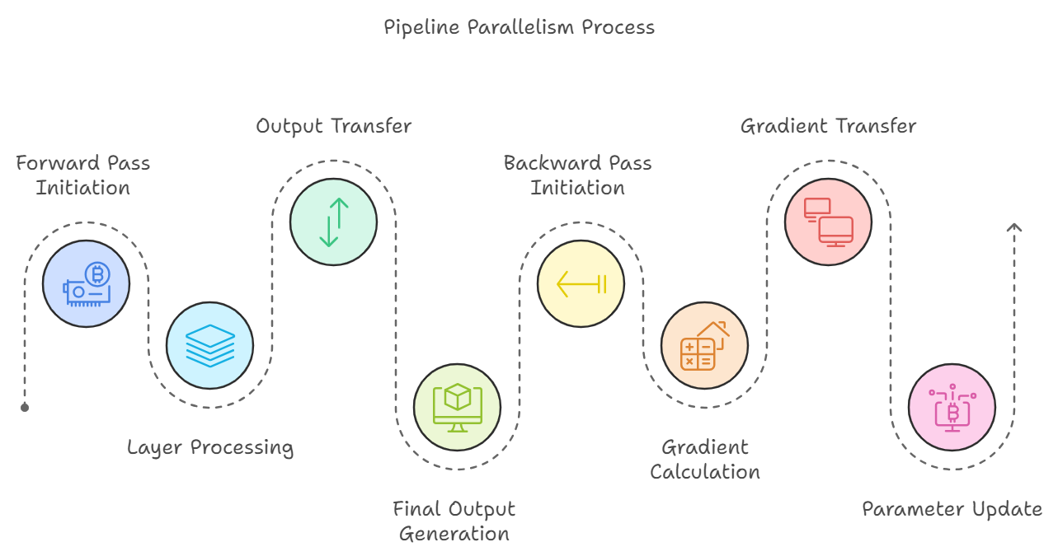

Slide 19
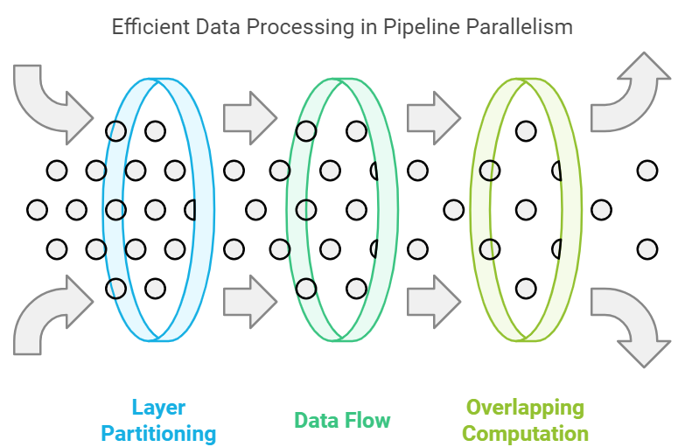
Model layers are divided and assigned to GPUs.
Gradient hazard
- register hooks
- activation
- trigger
Pinned direct memory access

Slide 20
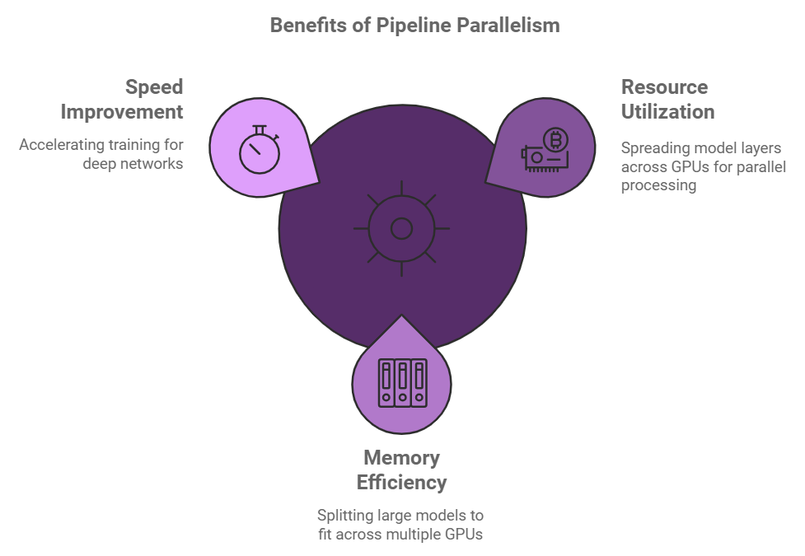

Slide 21
References
https://www.youtube.com/@3blue1brown
https://colah.github.io/
http://neuralnetworksanddeeplearning.com/
https://distill.pub/
http://neuralnetworksanddeeplearning.com/chap1.html

